Slide 1

The power of Data Science
Benjamin Dragenice
CTEC 298-101 Spring 2021

Slide 2
Introduction
Topics to be covered:
- Summary of CTEC 128 paper
- CTEC material submitted
- Plot deliverables
- Conclusion
- References

Slide 3
Summary of CTEC 128 Paper
The paper covers the various data techniques that were used
Talked about using data ingestion to retrieve our data for the project
Talked about data wrangling to narrow down our dataset
The paper was to see what factors play a part in creating a successful marriage
It was determined that employment status, race, and education level were the biggest factors in a marriage

Slide 4





CTEC Material Submitted

Slide 5
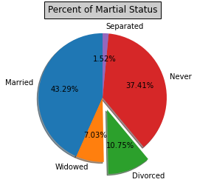
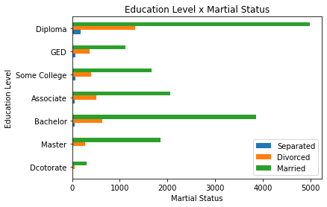
Plot Deliverables

Slide 6
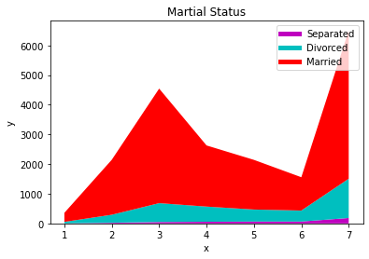
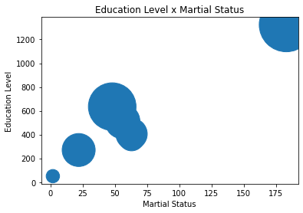
Plot Deliverables

Slide 7
Conclusion
Learned python through Dataquest tutorials
Matplotlib and pandas are powerful tools for data science
There are many tools that can be used in regard to data science

Slide 8
References
Herston, K. (2016, September 30). Biggest Factor in Divorce Is Husband's Employment Status, Says Harvard Study. Retrieved December 20, 2020, from https://herstontennesseefamilylaw.com/2016/10/05/biggest-factor-in-divorce-is-husbands-employment-status-says-harvard-study/
Crowley, J. C. (2020, November 3). What Are Common Reasons for Divorce? Survive Divorce. https://www.survivedivorce.com/common-reasons-for-divorce#8
US Census Bureau. (2020a, October 16). About the Survey. The United States Census Bureau. https://www.census.gov/programs-surveys/acs/about.html
Marriage. Retrieved December 20, 2020, from https://www.britannica.com/topic/marriage

